Slide 1
Welcome to Small Group 14!

Slide 2
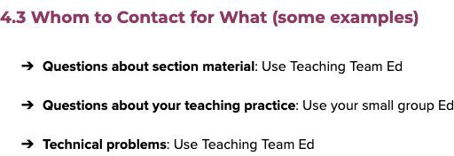

Slide 3
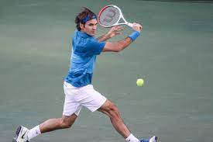
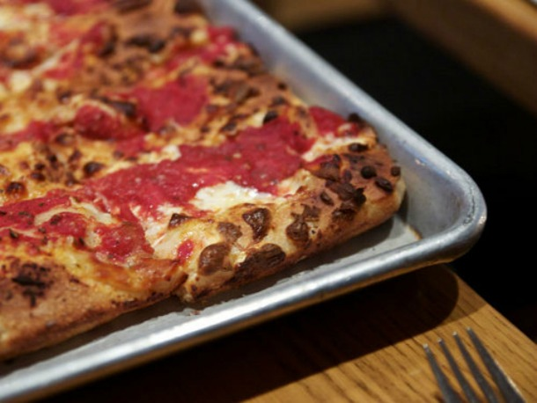
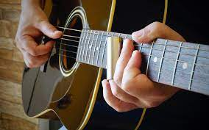
Hi, I’m Troy!

Slide 4


Optional Icebreaker Questions:
Favorite childhood food and what memorable experience do you have eating that food?
Best book or movie you’ve read or seen recently?
Favorite pastime during the pandemic?

Slide 5




section != lecture
●
●
●
●
Solidifying knowledge!

Slide 6




Slide 7
HospitalKarel

Slide 8

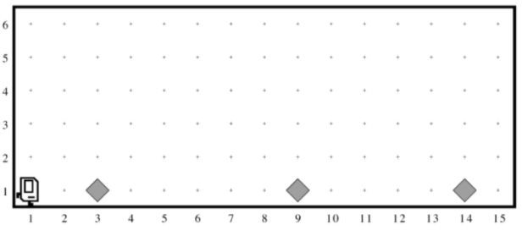

Slide 9
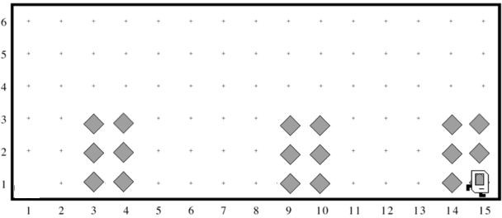

Slide 10



Slide 11
Code

Slide 12


●
●
●
●
●
●
●
●
●
●
●

Slide 14
●
●
●
●
●
Now it’s your turn...

Slide 15

●
●
●
●

Slide 16

●
●
●

Slide 17
●
●
○
○
○
○
●
●
Questions?

